Slide 1
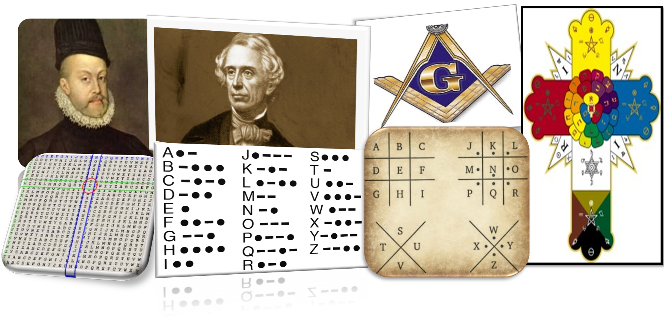
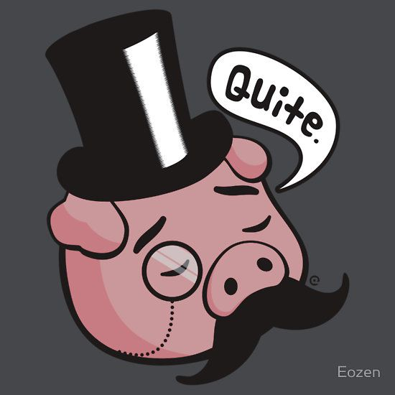
Vigenère, Morse and Pig pens!
Year 7 Term 4 – History of computing and code breaking

Slide 2


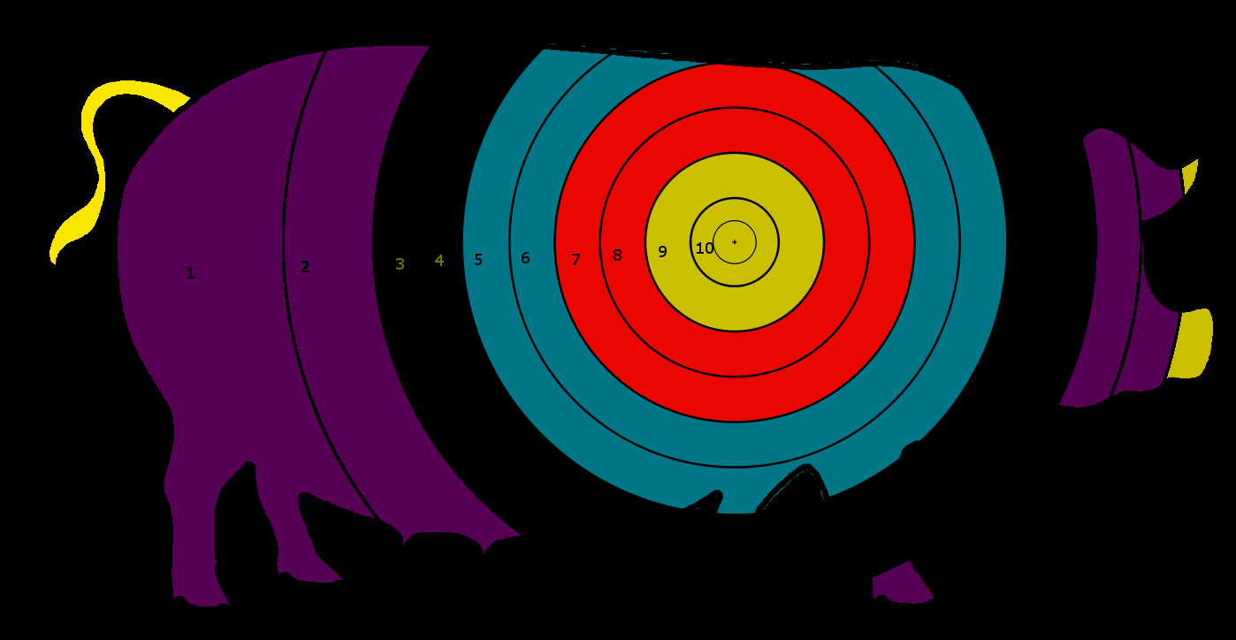
Targets for this lesson
I can describe who Charles Babbage and Ada Lovelace were and what they did.
I can identify reasons that secret societies use ciphers.
I can solve a pigpen cipher and Morse code with a machine.

Slide 3
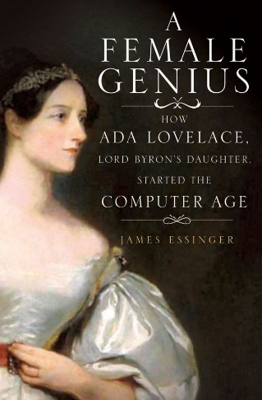
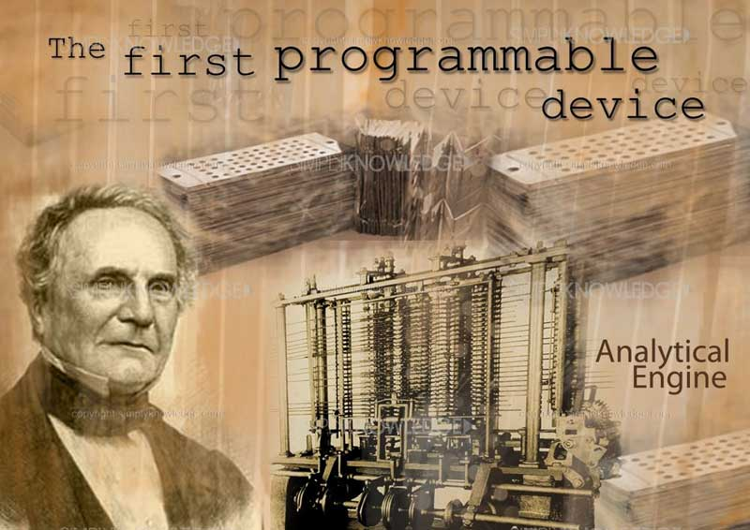
Starter
Research and write 3 facts about Charles Babbage and 3 facts about Ada Lovelace.
Fact 1:
Fact 4:
Fact 2:
Fact 5:
Fact 3:
Fact 6:

Slide 4
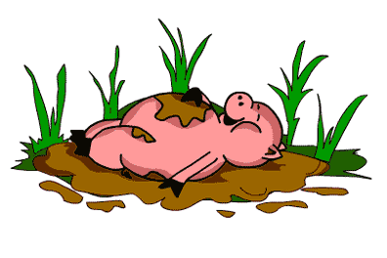
Who would use Pig pen code?
Research and explain
Who invented the Pig pen cipher code and for what purpose?
What was Pig pen code commonly used for?
I can identify reasons that secret societies use ciphers. (Step 2)

Slide 5
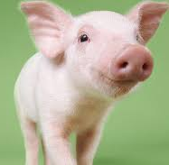
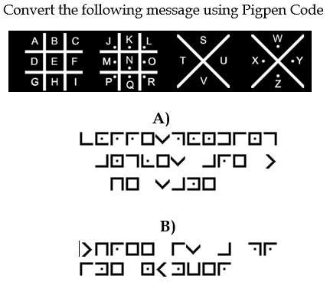
Pig pen cipher
Solve the pig pen cipher code in the image opposite.
Look at the lines and the dots instead of the letters in the cipher.
A)
B)
I can identify reasons that secret societies use ciphers.

Slide 6
Who would use Morse code?
Research and explain
Who invented Morse code and for what purpose?
What was/is Morse code commonly used for?
I can create and solve Morse code with a machine. (Step 4)

Slide 7
Morse code
Solve the Morse code message, in the picture opposite, below.
I can create and solve Morse code with a machine.

Slide 8
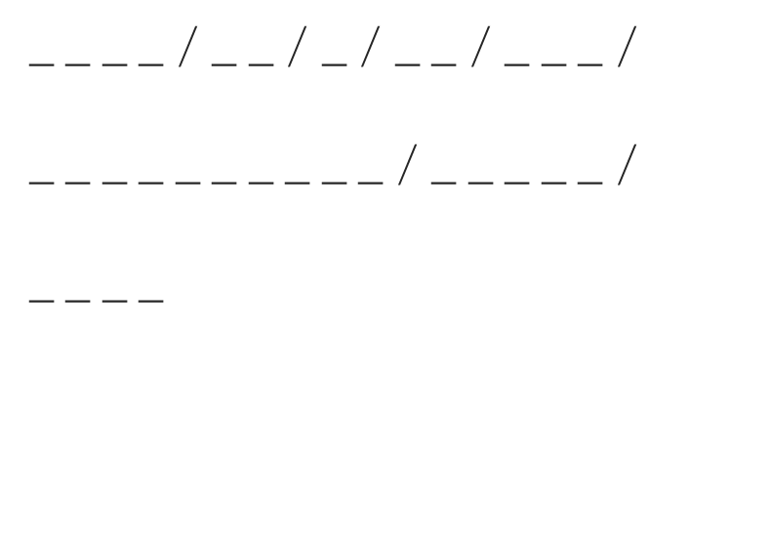
Listen and decode
Listen to the morse code letters being made by the morse code machine. Write them down as you hear them and see if you can work out what the message is saying.
H

Slide 9
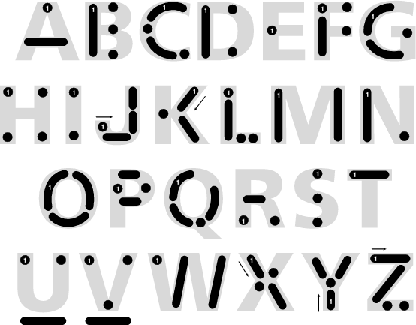
Invent your own coded messages to a friend.
Write either a Morse code message or a pigpen in this box and get your friend to solve it.
I can create and solve a coded message.

Slide 10
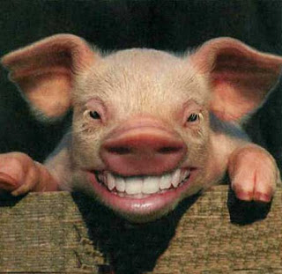
Explain how you have met your target grade. Give examples.
Give reasons that secret societies use ciphers.
Explain how you have created and solved Morse code.
Evaluate importance of further development of strong ciphers

