Slide 1
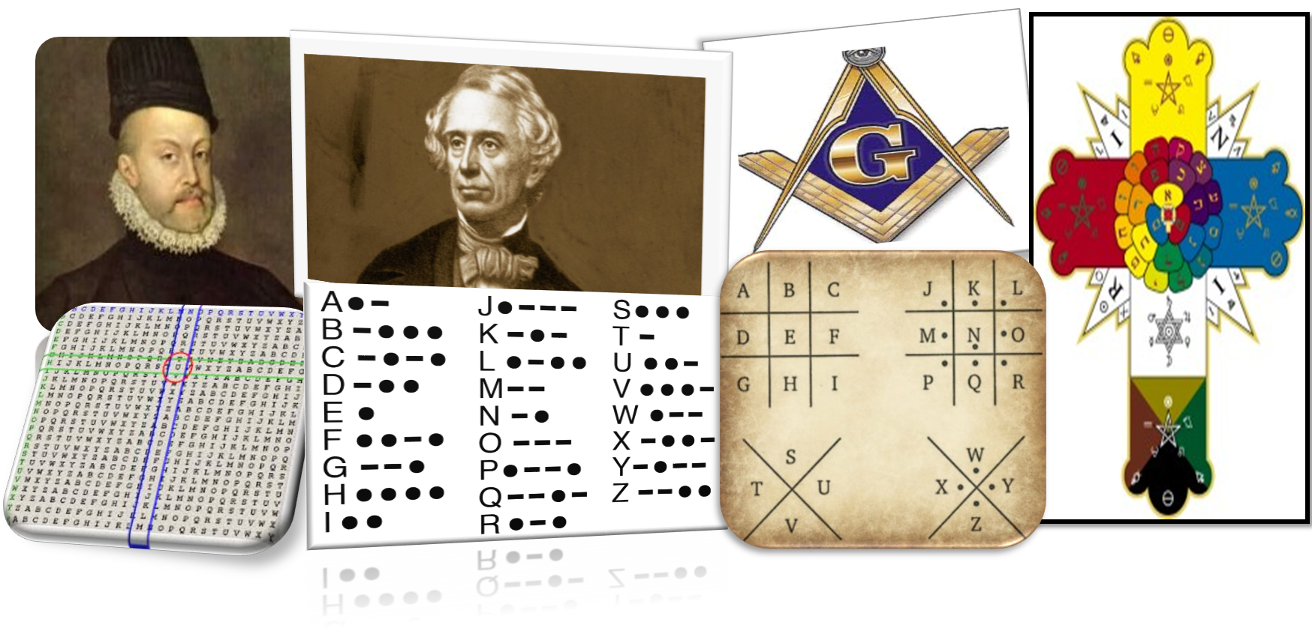
Vigenère and Frequency Analysis
Year 7 Term 5 – History of computing and code breaking

Slide 2


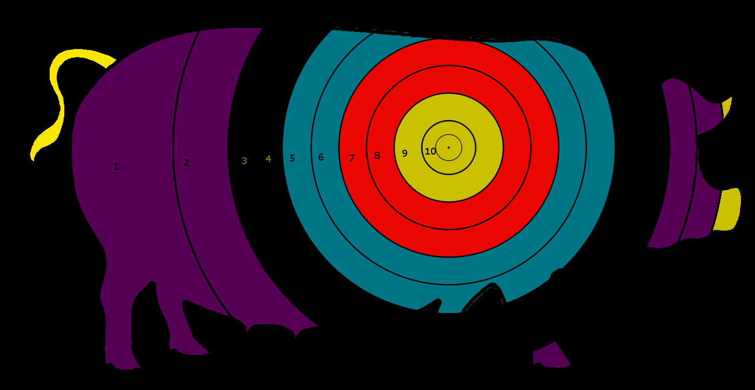
Targets for this lesson
I can use frequency analysis to crack codes without a key
I can evaluate the importance of further development of strong ciphers such as the Vigenère.

Slide 3
Frequency Analysis
Research and explain
What is Frequency analysis?
How is it used to decode an encrypted message ?
I can use frequency analysis to crack codes without having a key

Slide 4
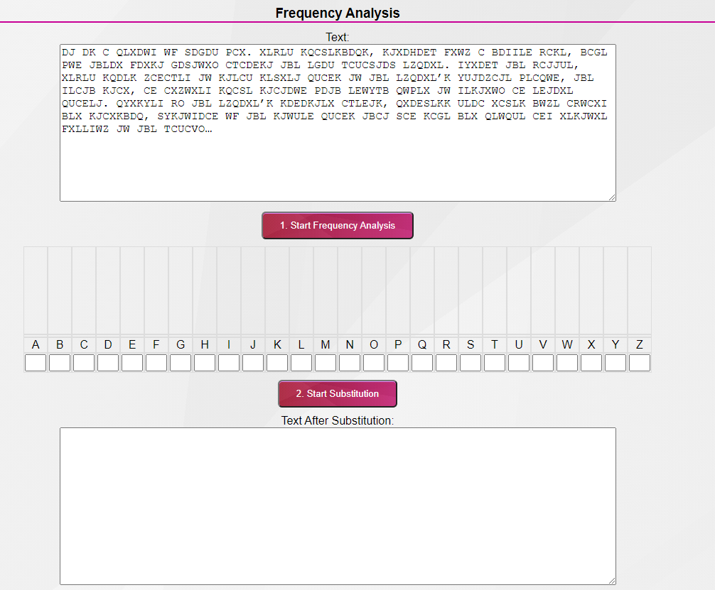
Decode the following message using Frequency Analysis
I can use frequency analysis to crack codes without having a key

Slide 5
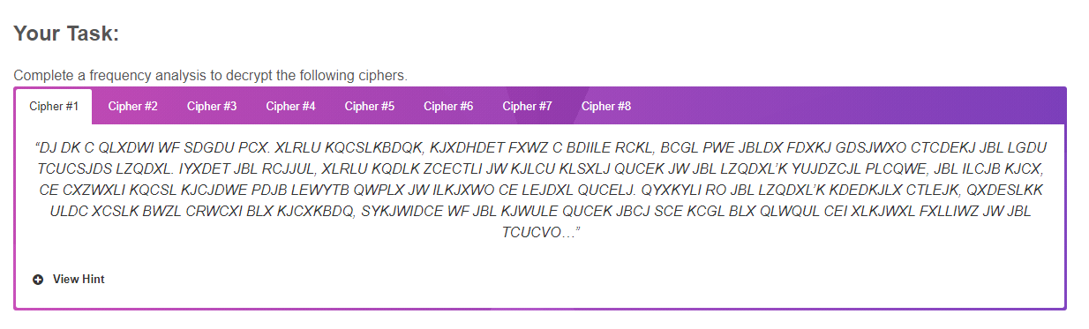
Extension – Decode as may of the coded messages as you can using frequency analysis
I can use frequency analysis to crack codes without having a key

Slide 6
The Vigenère cipher
Research and explain
Who the Vigenère cipher and for what purpose?
How is the Vigenère cipher used?
I can evaluate the importance of further development of strong ciphers such as the Vigenère.

Slide 7
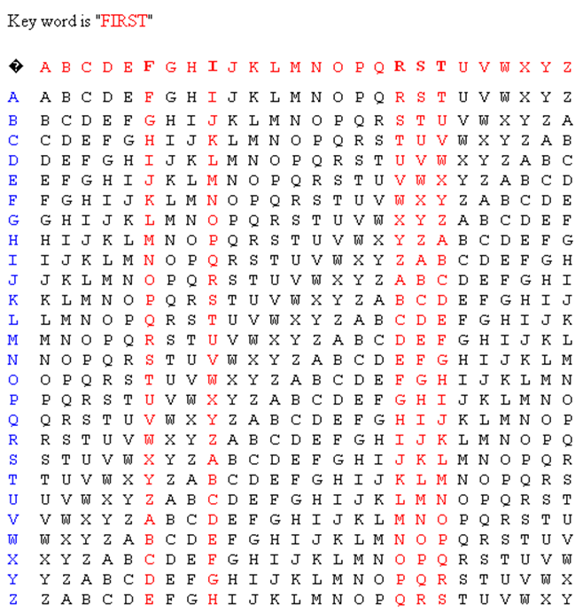
Vigenère cipher - solve
With the first letter B, we look down the F column – and find B. Then look across to the far left column - this gives us W.
Next we decode P by finding it in the I column, then looking across to the far left column – this will give H etc.
Solve the encrypted message using the Vigenère cipher with the Key word FIRST:
BPRLB XBYWM JVKZY NJFFT HKZFN RJVJ
Do the messages you are solving in this lesson seem strange to you? Why?
I can evaluate the importance of further development of strong ciphers such as the Vigenère.

Slide 8
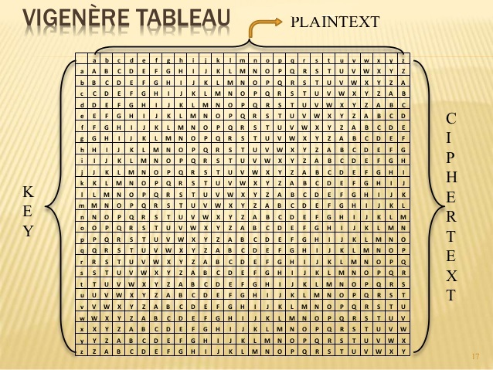
Vigenère cipher -create
Create your own key and encrypt a message in the box below.
Your key does not have to be a word, it can be a jumble of letters.
Write the message here:
Solve the message here:
I can evaluate the importance of further development of strong ciphers such as the Vigenère.

Slide 9
Evaluation
Explain how you have created and solved a Vigenère cipher .
Explain how you used frequency analysis to decode a secret message
Evaluate importance of further development of strong ciphers

